Slide 1


Tugas UAS Aplikasi Mobile
17081010055
17081010048

Slide 2

Daftar Acuan Penjelasan UAS - FINAL PROJECT
Sekilas tentang UPN “QuiZ” (Konsep dan kreativitas ide)
Activity
Intent
Layout
View
Viewgroup
Scrollview

Slide 3
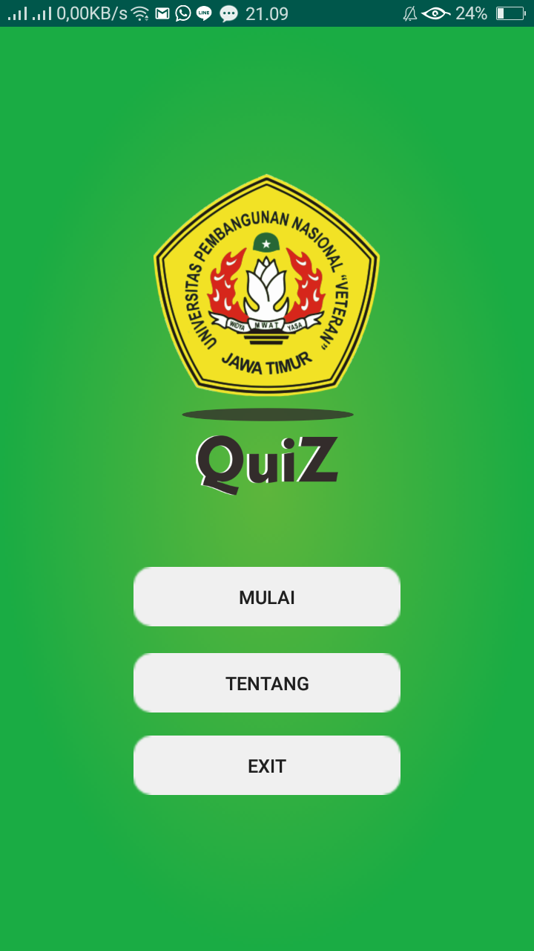
Sekilas tentang UPN “QuiZ”
Untuk memenuhi tugas Final Project aplikasi mobile, kami membuat aplikasi bernama “UPN QuiZ”.
Aplikasi ini bertujuan untuk lebih mengenalkan kampus UPN Veteran Jawa Timur dan memberikan wawasan seputar UPN “Veteran” Jawa Timur kepada mahasiswa agar lebih mengenal & cinta terhadap kampus, serta mengenalkan Jurusan Teknik informatika pada bidang kuis pemrograman.

Slide 4
Fitur Terbaru dari aplikasi kami ialah :
QUIZ GAMBAR : yaitu quiz berbasis gambar, dengan menampilkan gambar sebagai logika dalam pemecahan masalah.

Slide 5

Activity dan Intent
Dalam pembuatan aplikasi “UPN QuiZ” ini terdapat 7 buah Activity.
Activity ini saling terhubung dan mempunyai tugas yang berbeda-beda. Seperti contoh gambar di samping, terdapat activity pertama yang dijalankan setelah pengguna meluncurkan aplikasi melalui ikon aplikasi di layar device yaitu “main activity launcher” (SplashActivity).
SplashActivity ini melakukan posisi state onCreate() -> onStart() -> sleep 3s -> new intent() -> MainActivity() -> finish()
SplashActivity.java

Slide 6
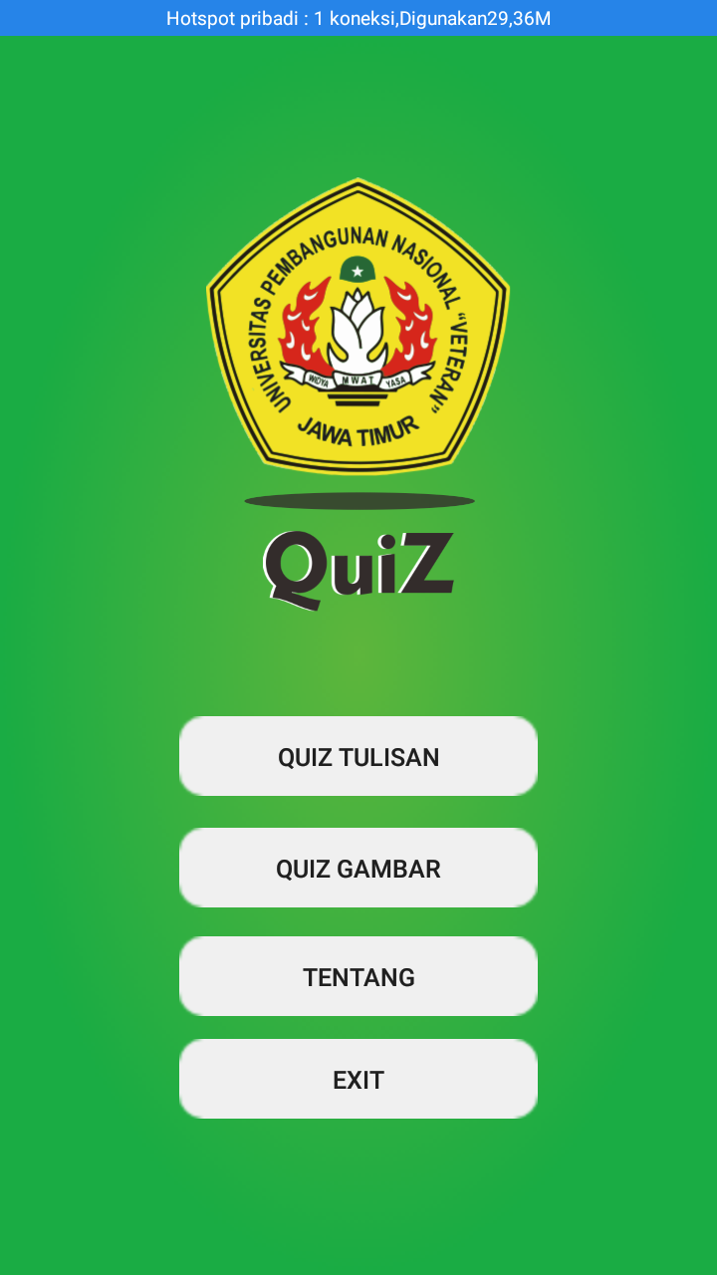
public void onClick(View view) { switch (view.getId()) { case R.id.btn_quiz_tulisan: Intent moveIntent1 = new Intent(MainActivity.this, KuisActivity.class); startActivity(moveIntent1); break;
case R.id.btn_quiz_gambar: Intent moveIntent3 = new Intent(MainActivity.this, quiz_gambar.class); startActivity(moveIntent3); break;
case R.id.btn_about: Intent moveIntent2 = new Intent(MainActivity.this, TentangActivity.class); startActivity(moveIntent2); break;
case R.id.btn_exit: moveTaskToBack(true); finish(); System.exit(0); break; } }

Slide 7
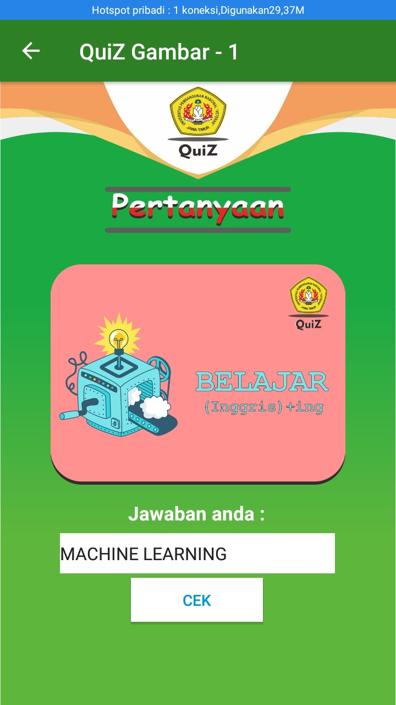
Dari layout Quiz Gambar – 1 :
User / pengguna menuliskan kalimat yang sesuai dengan gambar yang diberikan.
User diharuskan menjawab soal dengan benar sebelum melanjutkan quiz gambar selanjutnya.
Ketika user menjawab dengan benar, maka nilai / skors ditambah 1.
Jumlah soal quiz gambar yang harus terjawab ialah 5 buah soal.

Slide 8
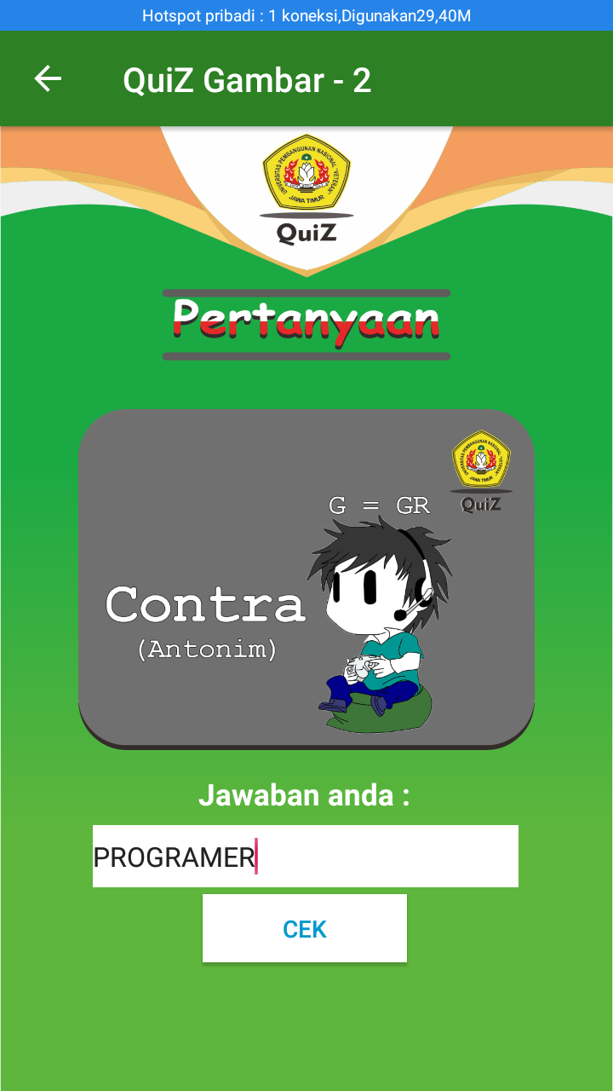
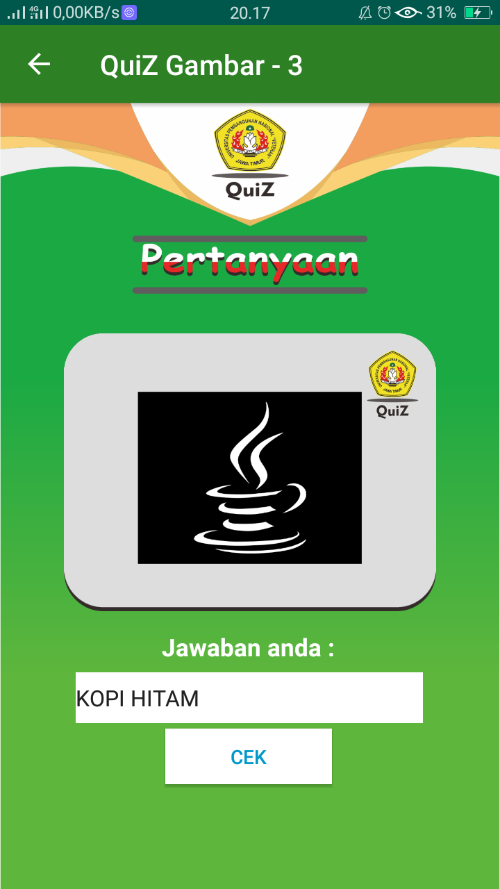
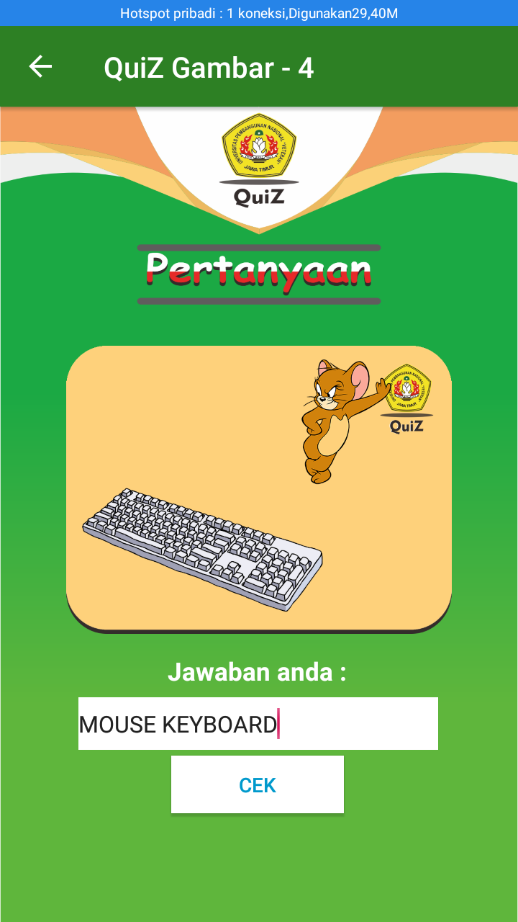
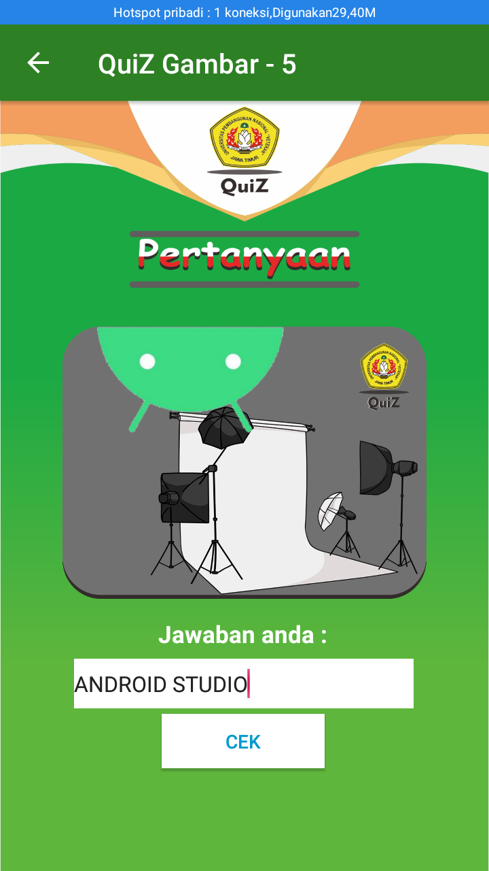

Slide 9
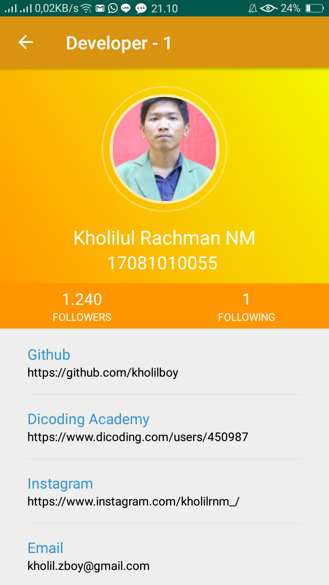
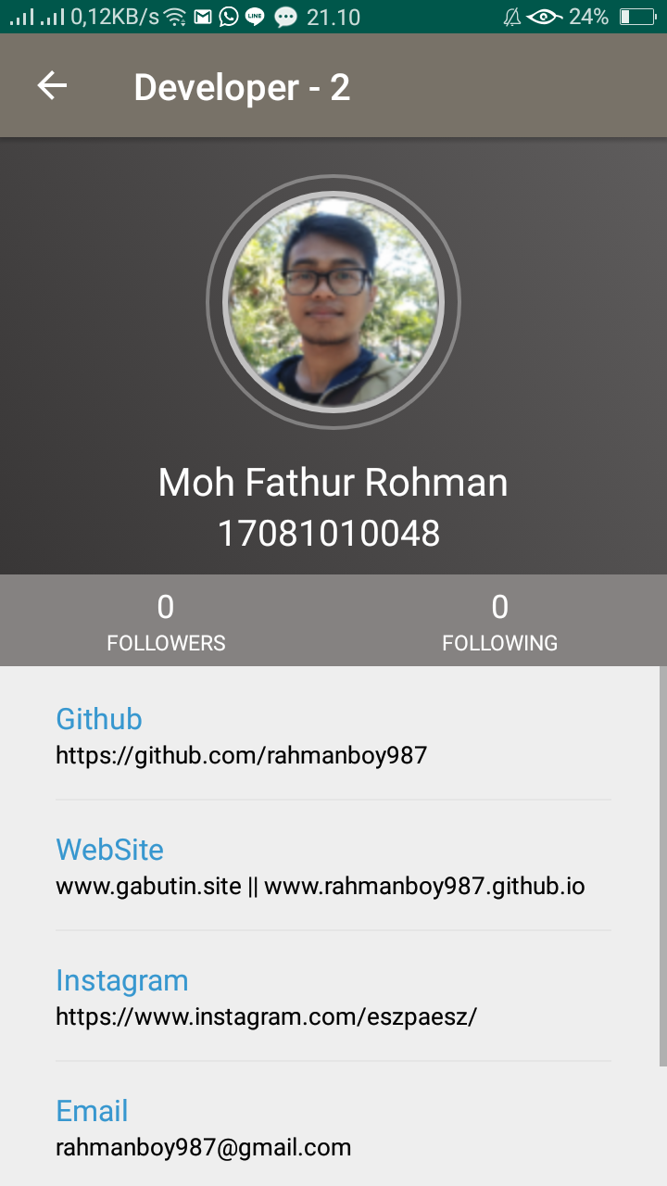
2 buah activity ini fungsinya hanya menampilkan layout dari resources :
activity_detail_developer.xml
&
activity_detail_developer1.xml
DetailDeveloper.java
DetailDeveloper1.java

Slide 10
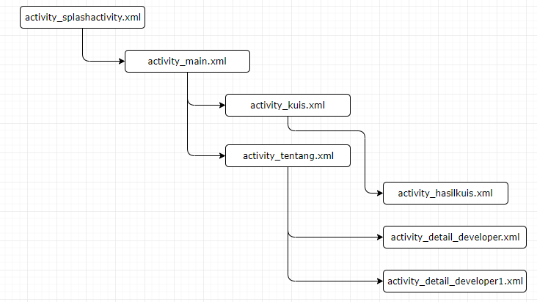
Layout, View dan Viewgroup serta ScrollView

Slide 11
activity_splashactivity.xml
ConstraintLayout -> (Viewgroup)
ImageView “quiz_text” -> (View)
ImageView “lingkaran_kuis” -> (View)
ImageView “logo_upn” -> (View)

Slide 12
activity_main.xml
ConstraintLayout -> (Viewgroup)
ImageView “quiz_text” -> (View)
ImageView “lingkaran_kuis” -> (View)
ImageView “logo_upn” -> (View)
Button “Mulai” -> (View)
Button “Tentang” -> (View)
Button “Exit” -> (View)

Slide 13
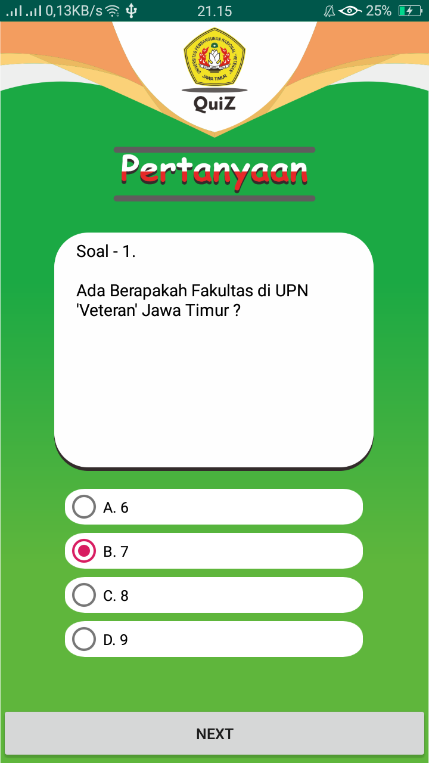
activity_kuis.xml
ConstraintLayout -> (Viewgroup)
View “kotak” -> (View)
ImageView “box kotak kuis” -> (View)
TextView “pertanyaan” -> (View)
RadioGroup
RadioButton (A)
RadioButton (B)
RadioButton (C)
RadioButton (D)
(View)
Button “Next” -> (View)

Slide 14
ConstraintLayout -> (Viewgroup)
View “kotak” -> (View)
ImageView “box kotak kuis” -> (View)
TextView “pertanyaan” -> (View)
EditText
Button “Next” -> (View)

Slide 15
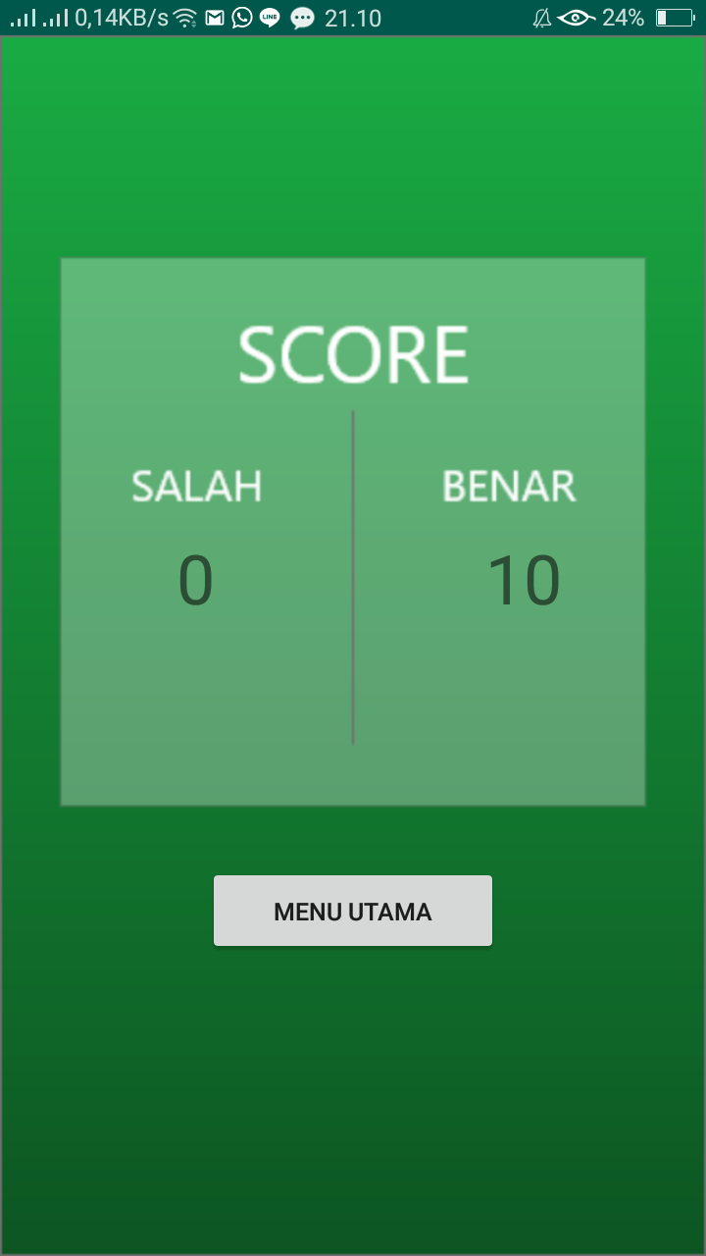
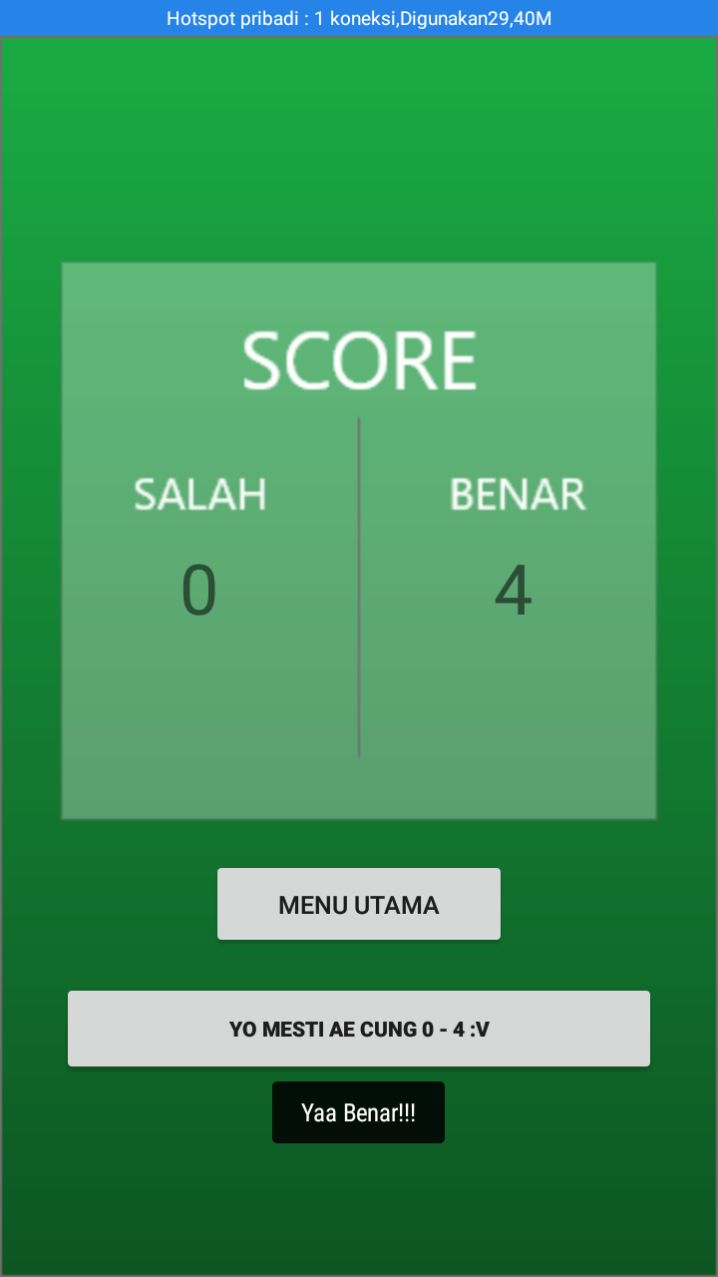
activity_hasilkuis.xml
activity_hasilkuis2.xml
ConstraintLayout -> (Viewgroup)
ImageView “kotak_skor” -> (View)
TextView “hasil” -> (View)
TextView “hasil1” -> (View)
Button “Menu Utama” -> (View)

Slide 16
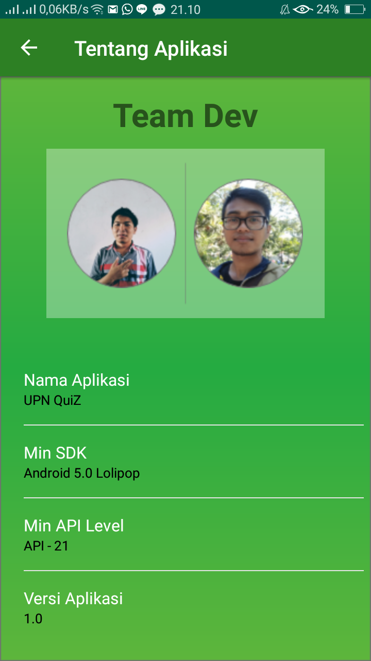
activity_tentang.xml
ConstraintLayout -> (Viewgroup)
TextView “kotak_box_about” -> (View)
ImageView “kotak_ttg” -> (View)
ImageView “colil_img” -> (View)
ImageView “fathur_img” -> (View)
ScrollView -> (Viewgroup)

Slide 17
ScrollView -> (Viewgroup)
LiniearLayout -> (Viewgroup)
LiniearLayout -> (Viewgroup)
TextView -> (View)
TextView -> (View)
View -> (View)

Slide 18
activity_detail_developer.xml
RelativeLayout0 -> (Viewgroup)
RelativeLayout1 -> (Viewgroup)
RelativeLayout2 -> (Viewgroup)
CircleImageView “circle_img” -> (View)
TextView “nama” -> (View)
TextView “Univ” -> (View)

Slide 19
RelativeLayout1 -> (Viewgroup)
RelativeLayout0 -> (Viewgroup)
LinearLayout -> (Viewgroup)
ScrollView-> (Viewgroup)
RelativeLayout -> (Viewgroup)
RelativeLayout -> (Viewgroup)
LinearLayout -> (Viewgroup)
LinearLayout -> (Viewgroup)
TextView -> (View)
LinearLayout -> (Viewgroup)
TextView -> (View)
TextView -> (View)
RelativeLayout -> (Viewgroup)
TextView -> (View)
LinearLayout -> (Viewgroup)
View -> (View)
TextView -> (View)
TextView -> (View)

Slide 20
activity_detail_developer1.xml
RelativeLayout0 -> (Viewgroup)
RelativeLayout1 -> (Viewgroup)
RelativeLayout2 -> (Viewgroup)
CircleImageView “circle_img” -> (View)
TextView “nama” -> (View)
TextView “Univ” -> (View)

Slide 21
RelativeLayout1 -> (Viewgroup)
RelativeLayout0 -> (Viewgroup)
LinearLayout -> (Viewgroup)
ScrollView-> (Viewgroup)
RelativeLayout -> (Viewgroup)
RelativeLayout -> (Viewgroup)
LinearLayout -> (Viewgroup)
LinearLayout -> (Viewgroup)
TextView -> (View)
LinearLayout -> (Viewgroup)
TextView -> (View)
TextView -> (View)
RelativeLayout -> (Viewgroup)
TextView -> (View)
LinearLayout -> (Viewgroup)
View -> (View)
TextView -> (View)
TextView -> (View)

